Slide 1
IEEE WOMEN IN ENGINEERING: WIE Affinity Groups & WIE Student Branch Affinity Groups
presented by
Mehrube “Ruby” Mehrubeoglu
IEEE R5 WIE Coordinator, 2019
(adapted from IEEE WIE Presentation)

Slide 2
About IEEE WIE

Slide 3
What is IEEE WIE?
Institute of Electrical and Electronics Engineers Women in Engineering (IEEE WIE) “The IEEE WIE is the largest international professional group in the world dedicated to furthering the interests of female engineers, offering online e-books, an award-winning magazine, and countless networking opportunities for women in the field.”
“IEEE Women in Engineering (WIE) is one of the largest international professional organizations dedicated to promoting women engineers and scientists and inspiring girls around the world to follow their academic interests to a career in engineering.”

Slide 4
IEEE WIE History
20th Anniversary Celebration
IEEE Board of Directors create ad-hoc WIE Program committee
Membership affinity group formation allowed
Report to IEEE Board of Directors (BoD)
Report to MELCC (MGA)
WIE Magazine launched
2014
1994
1999
2012
1994
2007
1997
2001
2013
1993
WIE changed from ad-hoc to standing committee
3,000 members
2008
15,000 members
IEEE appoints ad-hoc committee to investigate increasing female participation in IEEE
1999
Staff with EAB &
Committee report to IEEE BoD
$25 membership dues introduced
WIE – women in engineering
BoD – Board of Directors
EAB – Educational Activities Board
MELCC – Member Engagement and
Life Cycle Committee (now MGA)
MGA – Member Geographic
Activities

Slide 5
IEEE WIE has… (as of Oct 2018)
20,000+ members in more than 100 countries
800+ Affinity Groups and Student Branch Affinity Groups
Affinity groups provide the opportunity for members to network at a local level.
50+ WIE Committee volunteers driving global activities
1,000+ Conference attendees annually
10 Summits on 6 continents
4 annual IEEE WIE awards
Award-winning IEEE WIE Magazine…and much more!

Slide 6
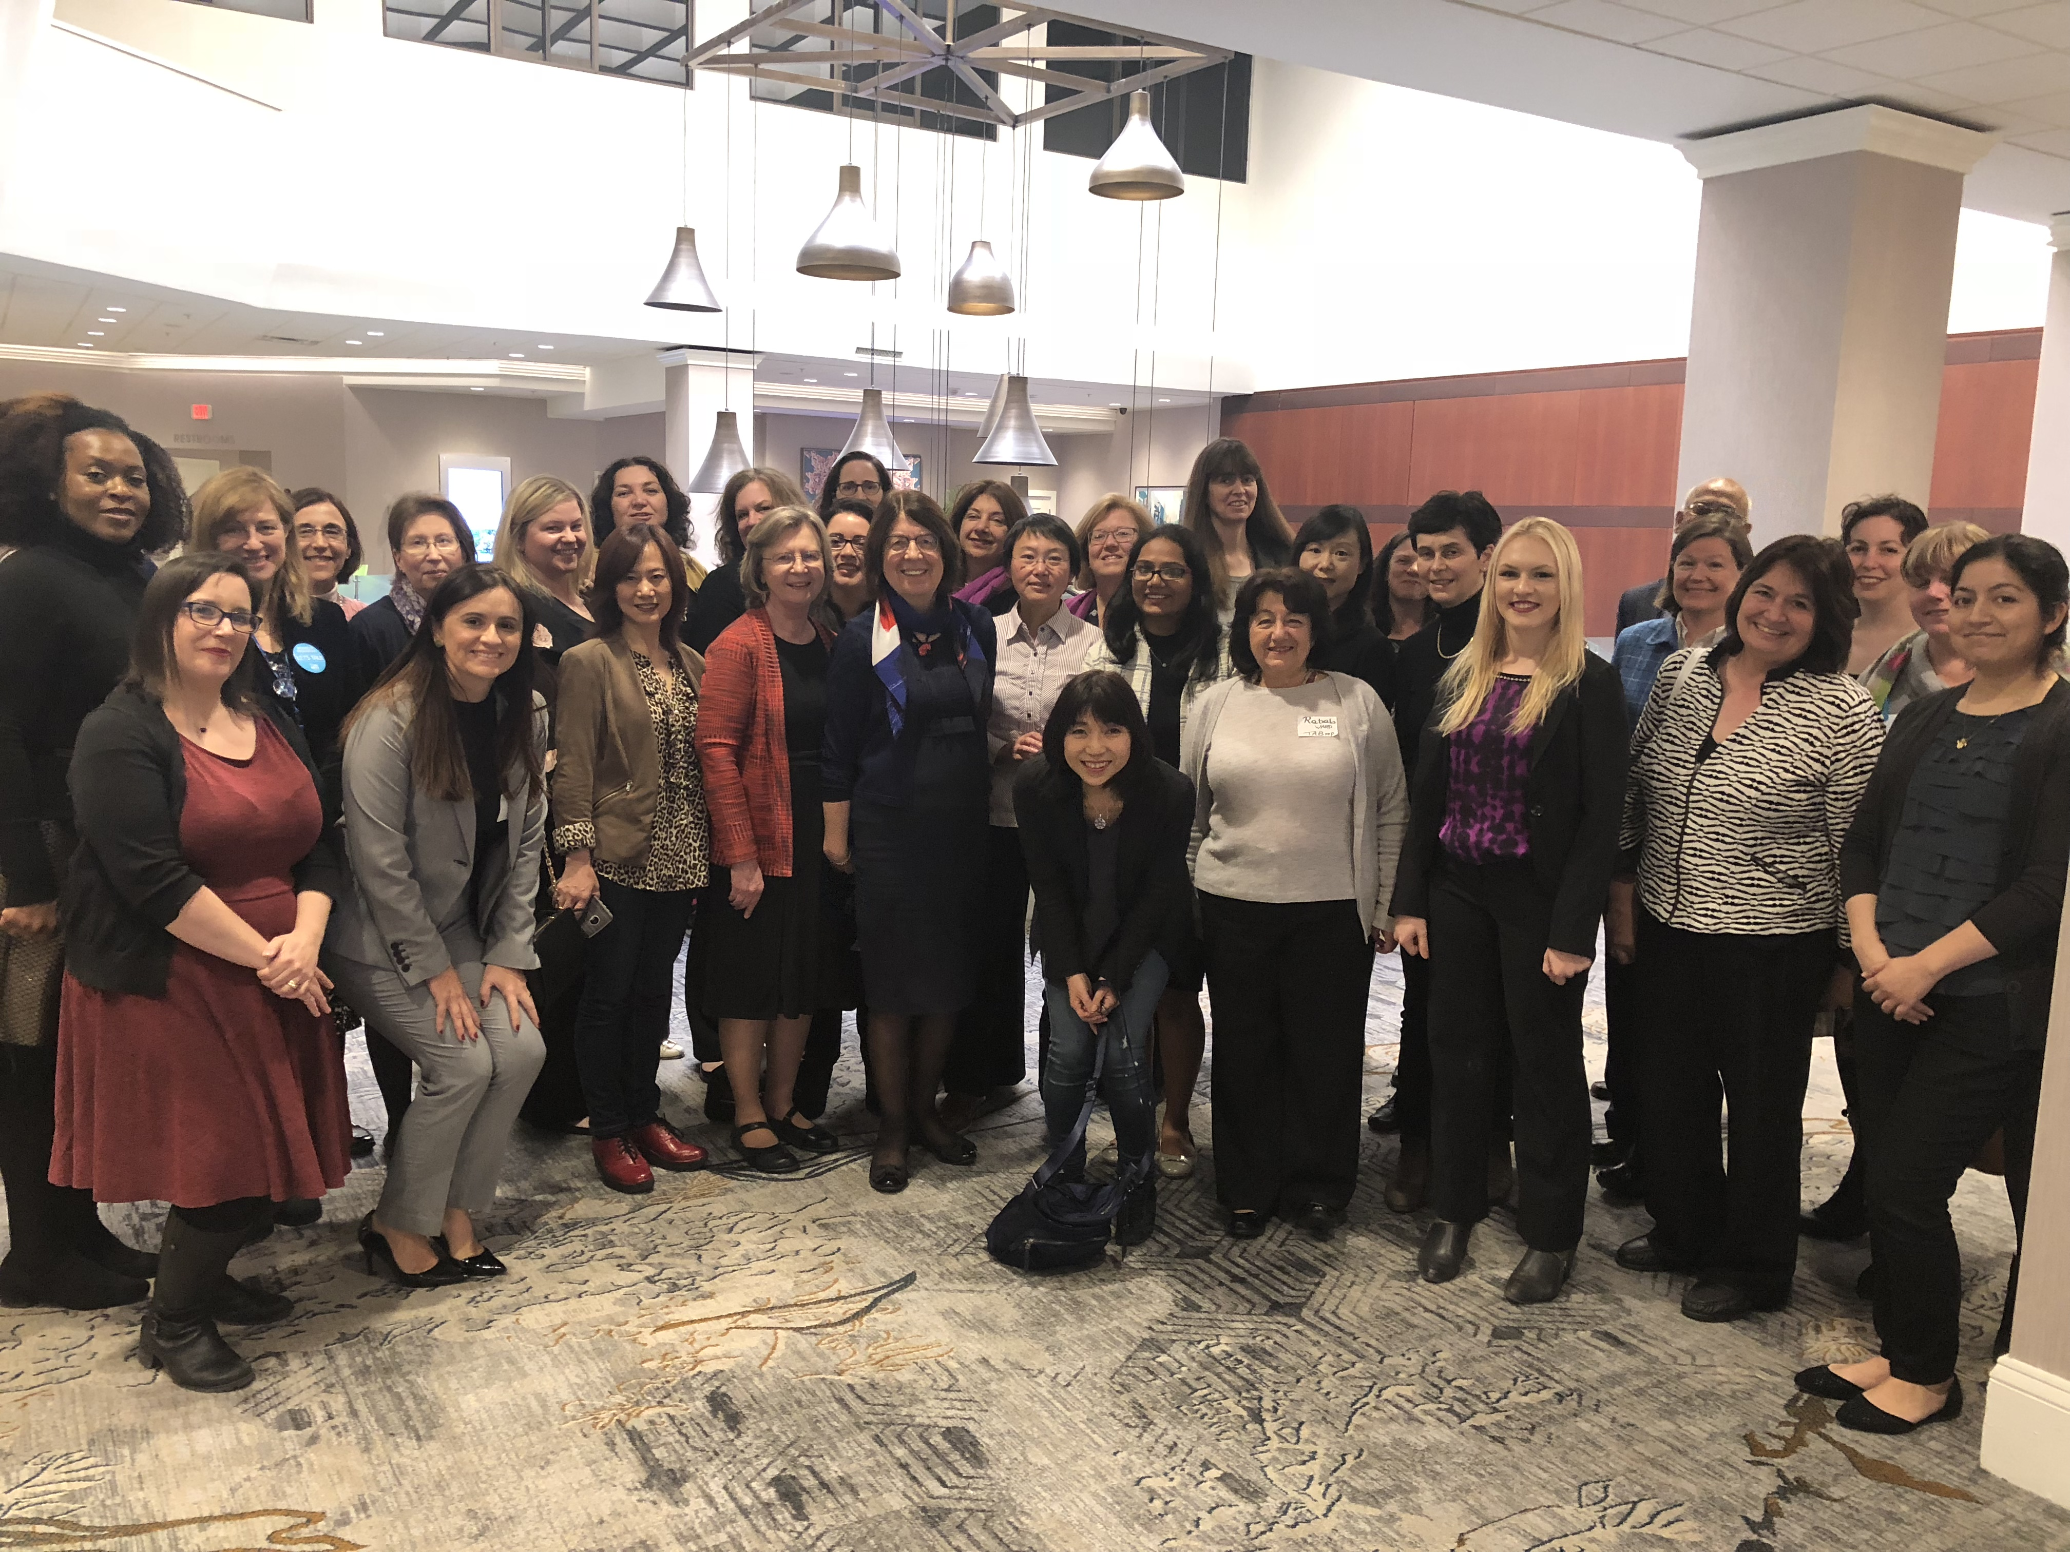
IEEE WIE Committee (WIEC)
1 Chair (Elected): Bozenna Pasik-Duncan
1 Past Chair: Takako Hashimoto
3 Elected Members
1-3yr term
4 Appointed Members
Technical Activities Board (TAB)
Young Professionals (YP)
Student Affinity Group
Professional Affinity Group
10 Region Coordinators
38 Society Liaisons
SA liaison
Publication Services and Products (PSPB) liaison
Sub-Committees & Ad-hocs

Slide 7
WIE Affinity Groups & Student Branches

Slide 8
What is a WIE Affinity Group (AG) or Student Branch Affinity Group (SBAG)?
Affinity groups provide the opportunity for members to network at a local level. All members are encouraged to join and participate in their local group activities to promote growth within WIE.
There are two types of WIE Affinity Groups; IEEE Section Affinity Groups (AG) and Student Branch Affinity Groups (SBAG).
Currently, there are over 800 WIE Affinity Groups worldwide in more than 100 countries.

Slide 9
Benefits of forming a WIE Affinity Group
Opportunity to network on a local level
Funding for events and activities. (Request must be submitted and approved by the IEEE WIE Committee.)
Option to announce regional news and upcoming events in the WIE Newsletter, the WIE website, and social media channels. Send all postings to women@ieee.org
Free WIE membership promotional items for affinity group meetings and events

Slide 10
WIE Affinity Group Statistics
As of December 2018
IEEE WIE Affinity Groups |  |  | (As of December 2018)
Region | # Affinity Group | # Student Branch | Total Affinity Groups
R1 | 14 | 4 | 18
R2 | 8 | 8 | 16
R3 | 11 | 8 | 19
R4 | 8 | 4 | 12
R5 | 8 | 3 | 11
R6 | 16 | 5 | 21
R7 | 16 | 14 | 30
R8 | 39 | 112 | 151
R9 | 25 | 154 | 179
R10 | 42 | 368 | 410
Total | 187 | 680 | 867

Slide 11
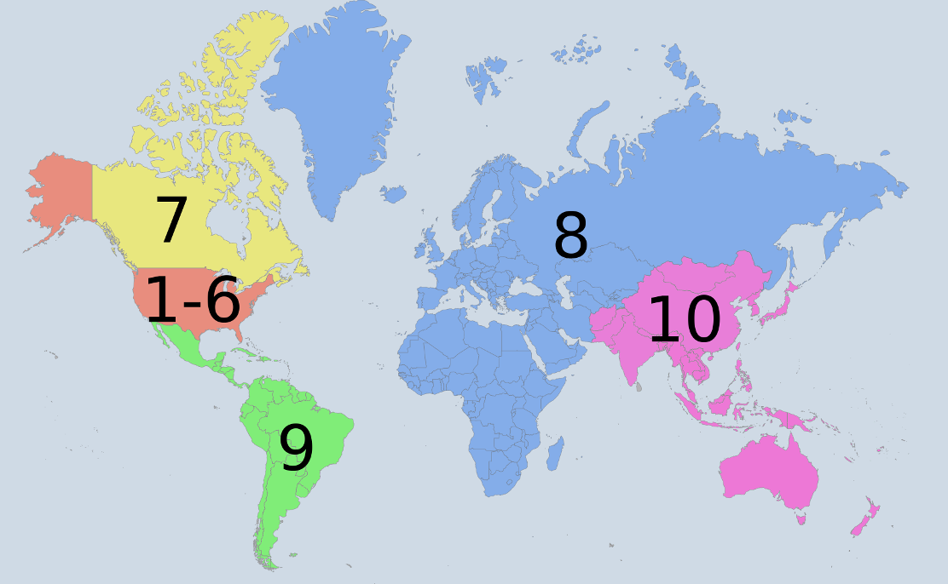
IEEE Regions
As of December 2018
http://ieeer8.org

Slide 12
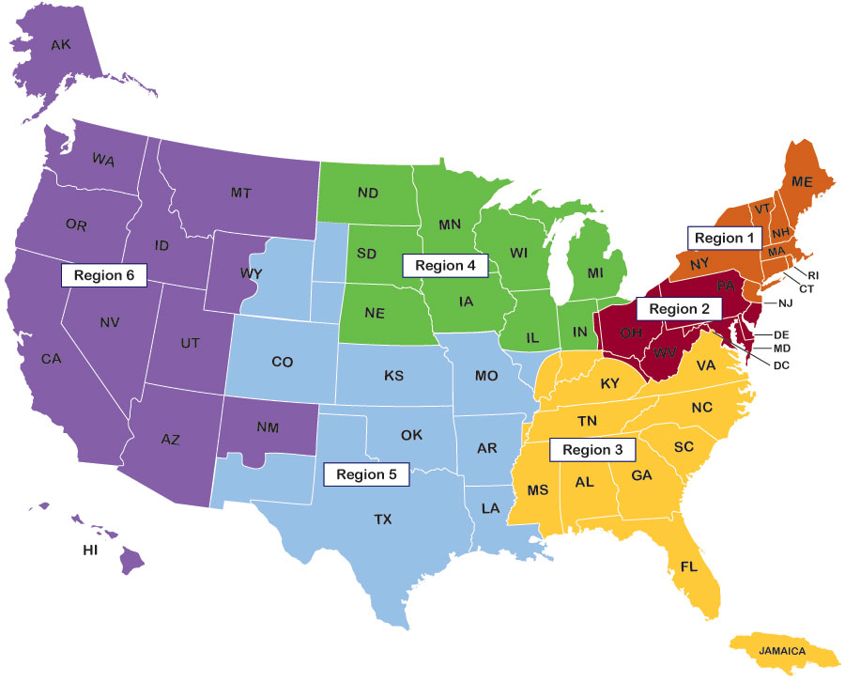
IEEE USA Regions
As of December 2018
http://ieeer5.org/home/region-map-sm/

Slide 13
HOW TO FORM AN AFFINITY GROUP
https://wie.ieee.org/how-to-form-a-wie-affinity-group/
Recruit six other IEEE Members who are willing to be part of the founding Affinity Group/Student Branch Affinity Group
Only one member has to be professional IEEE WIE member
Select someone to be responsible for the affinity group until the first meeting is held and the Officers are formally appointed
Sign a petition to form an AG/SBAG
Obtain your Section or Student Branch’s Executive Committee’s approval
(an Affinity Group depends administratively and financially on the Section)
Submit a petition

Slide 14
HOW TO FORM AN AFFINITY GROUP – PETITION FORM
https://www.ieee.org/communities/forms_petitions.html#Affinity-Group
Click here!
(not Women in Engineering)

Slide 15
HOW TO FORM AN AFFINITY GROUP – PETITION FORM
* Log in with your IEEE account. Then, click on Create New Petition:
Click here!
(after loggin into your IEEE account)
Click here!
(not Women in Engineering)

Slide 16
HOW TO FORM AN AFFINITY GROUP – PETITION FORM
* You will see your member information. Click on Next to get to:
Select Affinity Group/Joint Affinity Group

Slide 17
Opportunities in R3 and R5
IEEE WIE Membership
(Includes member, senior member, graduate student member, student member)
 | Year End |  | Current Count
 | 2017 | 2018 | As of 2-26-19
R3 | 568 | 591 | 401
R5 | 447 | 467 | 314
US | 3,587 | 3,707 | 2,525
Total | 22,966 | 21,809 | 10,951

Slide 18
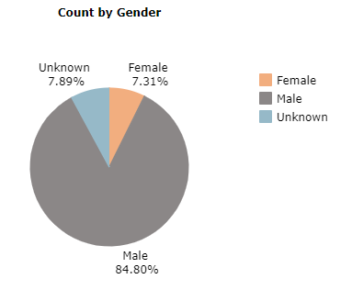
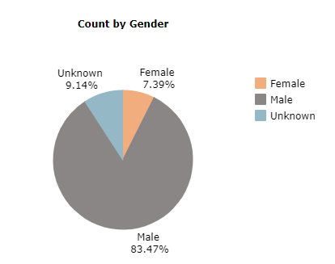
More Opportunities in R3 and R5
R3 and R5 Members Who Identify Themselves as Female
Region 3
Region 5

Slide 19
Region 3 & 5 Membership Statistics
All Membership
REGION | TOTAL MEMBERS
 | Jan-19
1 | 29,807
2 | 25,362
3 | 27,882
4 | 20,093
5 | 25,792
6 | 52,103
R 1-6 | 181,039

Slide 20
Recruiting volunteers for a WIE Affinity Group
Log on to IEEE OU Analytics (previously known as SAMIEE) to run a report of members in your area https://mga.ieee.org/resources-operations/volunteer-tools/samieee
If you’re unable to obtain the information you need, contact WIE as soon as possible.
IEEE Member and Geographic Activities (MGA) has a volunteer recruitment tool kit available. https://mga.ieee.org/resources-operations/geographic-unit/vitality/recruitment-toolkit

Slide 21
IEEE Required Reporting
Reports can be submitted Electronically for Section WIE Affinity Groups (L31s).
WIE Student Branch Affinity Groups should report all meetings including social events and administrative meetings to their Student Branch and women@ieee.org
For Reporting Requirements visit https://mga.ieee.org/resources-operations/geographic-unit/reporting-rebates

Slide 22
Reporting Officer changes
Affinity Groups must report names & members numbers of the Affinity Group Chair and Affinity Group Treasurer
Use online Officer Confirmation form https://officers.vtools.ieee.org/
Remember to do so after elections
WIE AG and SBAG Chairs must send an email to women@ieee.org with updated email and contact information yearly or whenever there is an officer change

Slide 23
Activities of an AG or SBAG
Host events
Pre-University Educational Outreach
University/Professional Outreach
Lectures
Workshops
Professional and Career Development Activities
Networking events
Eweek
Help to increase IEEE and WIE Membership
STAR events

Slide 24
STAR events (Pre-university initiative)
The IEEE Women in Engineering STAR Program was developed to address the growing concern that, at a young age, girls are discouraged from careers in mathematics, science, and engineering.
Sample of STAR activities:
Classroom Activities
Humanitarian Projects involving the pre-university community
Competitions
Training of pre-university teachers
Mentoring
More information on STAR can be found at http://wie.ieee.org/ieee-wie-star/

Slide 25
Free Web Hosting
WIE Affinity Groups are encouraged to establish websites. Website hosting is available to Affinity Groups and Student Branches through the IEEE Entity Web Hosting program. The program allows groups to develop, create & maintain their own websites on an IEEE host.
For more information, please visit http://sites.ieee.org/

Slide 26
WIE AG / SBAG Support

Slide 27
Affinity Group Email Addresses
All WIE Affinity Groups are encouraged to develop a general email address for their group. This will be the official contact year to year. This will allow continuous communication once a new chair is appointed.
Example: wie-UAE@gmail.com or wie-utahstate@gmail.com* or
wie-TAMUCC@islander.tamucc.edu
Once the address has been created please inform staff at women@ieee.org

Slide 28
WIE Affinity Group Chair Email List
The WIE Staff monitored email alias for WIE Affinity Group Chairs, at IEEE level, is
wie-officers@ieee.org.
All WIE Staff communication intended for WIE AG Chairs will be done through the use of the above email alias. Therefore, please be sure the current officers are updated with WIE Staff and using vTools.
List includes
WIE AG Chairs
WIEC Chair
WIE Staff
WIE Regional Coordinators

Slide 29
WIE Promotional Items
Currently unavailable
Promotional materials may be requested at http://wie.ieee.org/wie-promotional-material-request-form/
If promotional items are requested for an event, a report must be submitted to women@ieee.org
Promotional items must be requested at least 3 weeks prior to an event.

Slide 30
WIE Funding

Slide 31
Initial Funding
Newly established WIE AGs and SBAGs are eligible to request up to $200 US in initial funding.
This type of funding may be requested only once.
To submit a request, please visit http://wie.ieee.org/ieee-women-in-engineering-affinity-group-initial-funding-request-form/

Slide 32
Special Funding
Established WIE Affinity Groups are eligible to request up to $400 US for special projects.
Must be submitted at least 3 months prior to the activity.
WIEC will review the request at their next scheduled meeting.
The WIE Affinity Group will be advised if the request has been approved.
If a report is not received for special funding, future funding may not be approved.
To submit a request, please visit http://wie.ieee.org/special-funding/

Slide 33
Other Funding (IEEE Region 5*)
Proposed/requested up to $500 from IEEE R5 leadership for high-impact WIE Affinity Group/Student Branch Affinity Group activities within IEEE Region 5
Will review on a first-come first served basis
Recommended submission: submit at least 2 months prior to the activity.
WIE Coordinator and Area Chairs will review submission
The WIE AG/SBAG will be advised if the request has been approved
Receipts for all expenses, and a report with pictures will be expected
For more information or to submit a request, send e-mail to Ruby Mehrubeoglu, IEEE R5 WIE Coordinator at ruby.mehrubeoglu@ieee.org
* pending approval and availability of funds

Slide 34
Leadership Training and Engagement Opportunities

Slide 35
WIE International Leadership Conference
Austin, Texas, 23-24 May, 2019
IEEE R3 Annual Meeting
(in conjunction with IEEE SoutheastCon)
Huntsville, Alabama, 12-14 April 2019
IEEE R5 Annual Meeting & Student Competitions
(in conjunction with IEEE GreenTech Conference)
Lafayette, Louisiana, 5-6 April 2019

Slide 36
National Engineers Week
International Women’s Day
Various Locations (make it YOUR location), 8 March 2019 (and annually)
Various Locations (make it YOUR location), February 16-22, 2020
Introduce a Girl to Engineering Day
“Girl Day”
Various Locations (make it YOUR location), 22 February (or other), 2020

Slide 37
WIE Awards

Slide 38
WIE Affinity Group of the Year Awards
The WIE Affinity Group of the Year Awards are given annually to one WIE Affinity Group and one WIE Student Affinity Group that has shown outstanding leadership and initiative in organizing activities.
WIE AG of the Year
Based on activities that took place between 1 January to 31 December of the previous year
Nominations due on 1 April.
WIE SBAG of the Year
Based on activities that took place between 1 July to 1 April of the previous year
Nominations due on 1 April.
The winning WIE Affinity Group and the WIE Student Branch Affinity Group will each be awarded a subsidy in the amount of US$500, and a certificate, and an appointment to the WIE Global Committee.

Slide 39
Inspiring Member and Student Member Awards
The WIE Inspiring Member Awards are given annually to one member and one Student member that have shown outstanding leadership and initiative in organizing activities.
WIE Inspiring Member Award
Nominations due on 1 April.
WIE Inspiring Student Member Award
Nominations due on 1 April.
The winners will each be awarded a subsidy in the amount of US$500, and a certificate.

Slide 40
IEEE WIE Quiz

Slide 41
IEEE WIE Quiz
All IEEE members who identify themselves as female are members of IEEE WIE
True ____ False

Slide 42
IEEE WIE Quiz
All IEEE members who identify themselves as female are members of IEEE WIE
True ____ False X

Slide 43
IEEE WIE Quiz
All IEEE members who identify themselves as female are members of IEEE WIE
True ____ False X
Only IEEE members who identify themselves as female may become members of IEEE WIE
True ____ False

Slide 44
IEEE WIE Quiz
All IEEE members who identify themselves as female are members of IEEE WIE
True ____ False X
Only IEEE members who identify themselves as female may become members of IEEE WIE
True ____ False X

Slide 45
IEEE WIE Quiz
All IEEE members who identify themselves as female are members of IEEE WIE
True ____ False X
Only IEEE members who identify themselves as female may become members of IEEE WIE
True ____ False X
IEEE WIE members engage in exactly the same services/activities as SWE
True ____ False _

Slide 46
IEEE WIE Quiz
All IEEE members who identify themselves as female are members of IEEE WIE
True ____ False X
Only IEEE members who identify themselves as female may become members of IEEE WIE
True ____ False X
IEEE WIE members engage in exactly the same services/activities as SWE
True ____ False X_

Slide 47
IEEE WIE Quiz
What does AG stand for?

Slide 48
IEEE WIE Quiz
What does AG stand for?
AFFINITY GROUP

Slide 49
IEEE WIE Quiz
What does AG stand for?
AFFINITY GROUP
What does SBAG stand for?

Slide 50
IEEE WIE Quiz
What does AG stand for?
AFFINITY GROUP
What does SBAG stand for?
STUDENT BRANCH AFFINITY GROUP

Slide 51
IEEE WIE Quiz
What does AG stand for?
AFFINITY GROUP
What does SBAG stand for?
STUDENT BRANCH AFFINITY GROUP
How many IEEE members does it take to start a WIE Affinity Group/Student Branch Affinity Group?

Slide 52
IEEE WIE Quiz
What does AG stand for?
AFFINITY GROUP
What does SBAG stand for?
STUDENT BRANCH AFFINITY GROUP
How many IEEE members does it take to start a WIE Affinity Group/Student Branch Affinity Group?
6

Slide 53
IEEE WIE Program Staff:
IEEE Region Volunteers:
Charmain Williams, WIE Senior Manager
c.t.williams@ieee.org
Paola Bringas, WIE Program Coordinator
p.bringas@ieee.org
Georedna Onyesoh, WIE Program
Marketing Specialist
g.onyesoh@ieee.org
Francesca Mingione, MGA Events Manager
f.mingione@ieee.org
Allison Mercer,
IEEE Region 3 WIE Coordinator
Allison.Mercer@gtri.gatech.edu
Ruby Mehrubeoglu,
IEEE Region 5 WIE Coordinator
ruby.mehrubeoglu@ieee.org
Visit IEEE WIE at wie.ieee.org
Email: women@ieee.org

